Slide 1
Group 19 Progress Update
3rd Mentor Meeting – 07/03/23

Slide 2
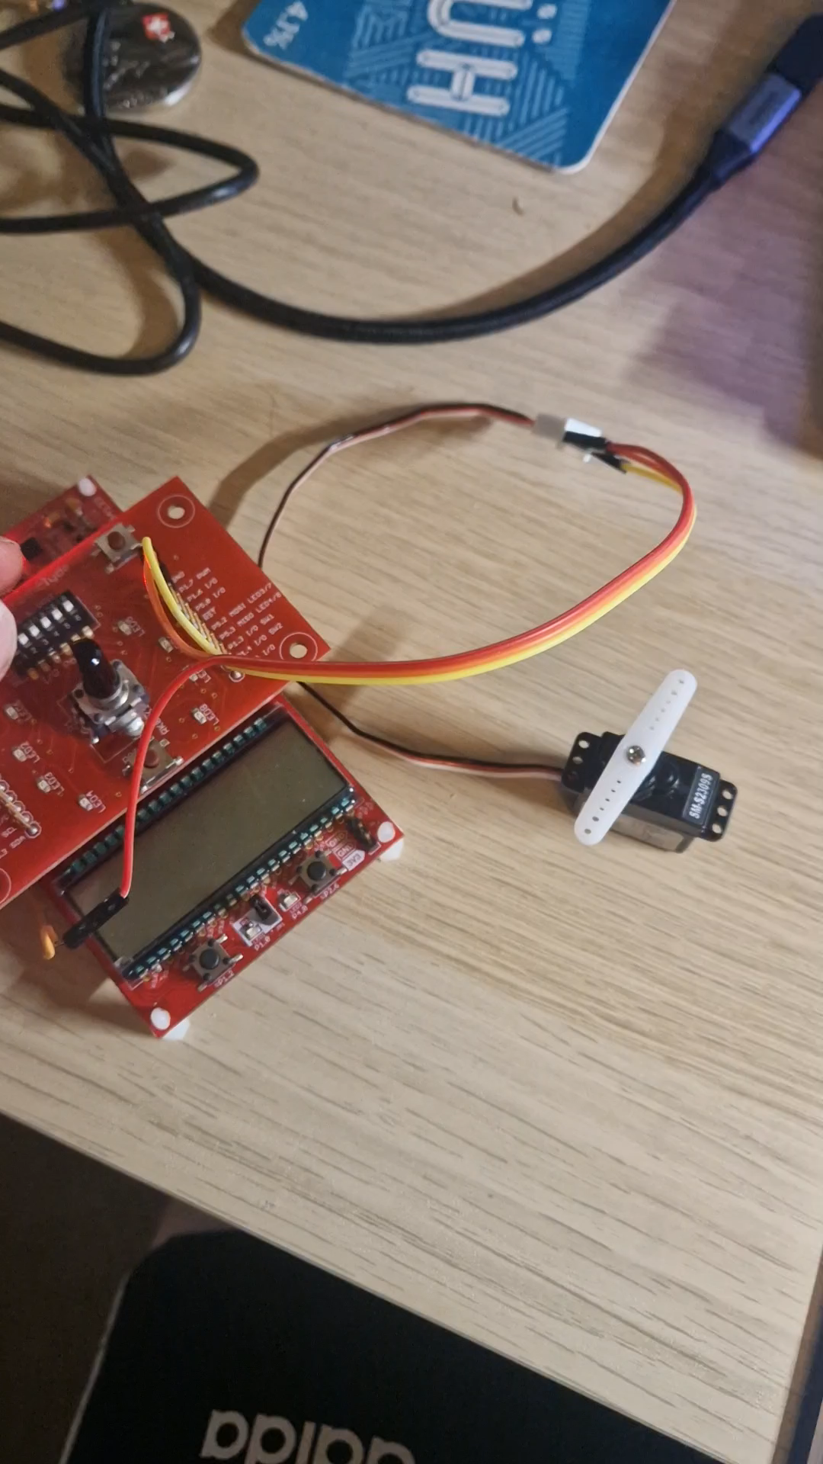
Servo Motor
Pulse widths to reach limits (0 & 180 degrees) found.
Servo motor control functions developed.
Manual control achieved with potentiometer.

Slide 3
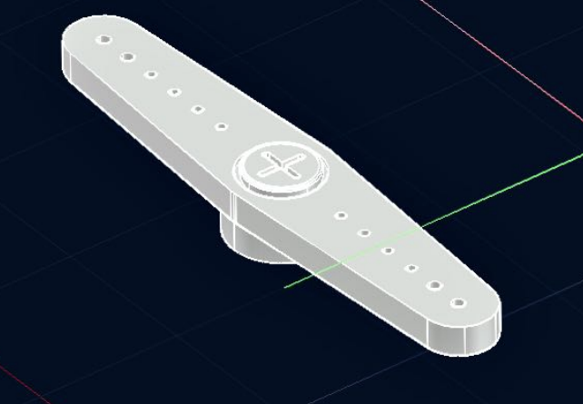
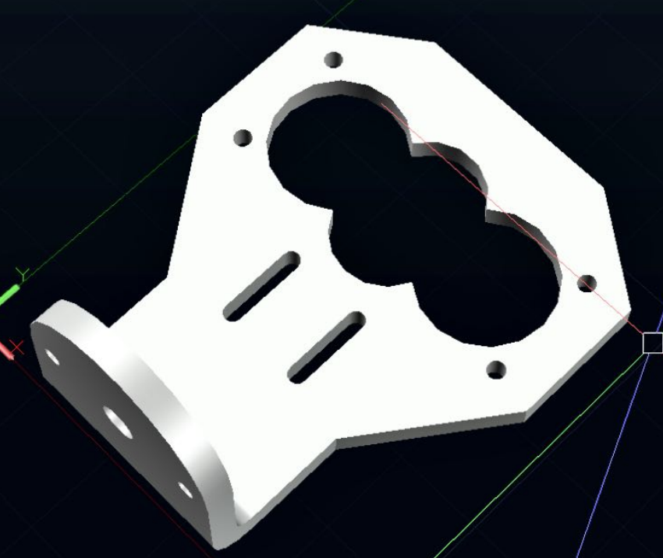
CAD
Fans
Connection structure

Slide 4
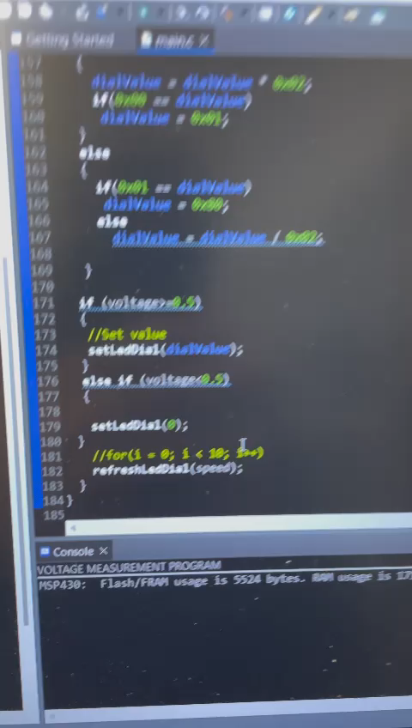
Power Measurement
The Voltage measuring system was tested more in-depth in the lab using a DMM. (video attached)
The formula for calculating the Power was updated to V2/R.
Investigation on which PV Cell should be used in our project was made.

Slide 5
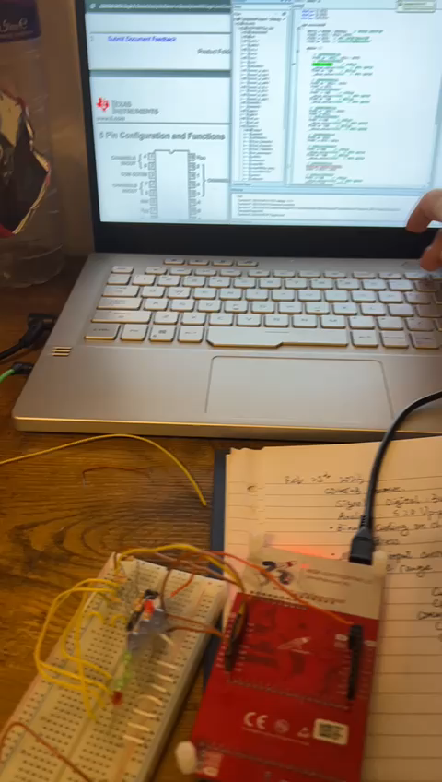
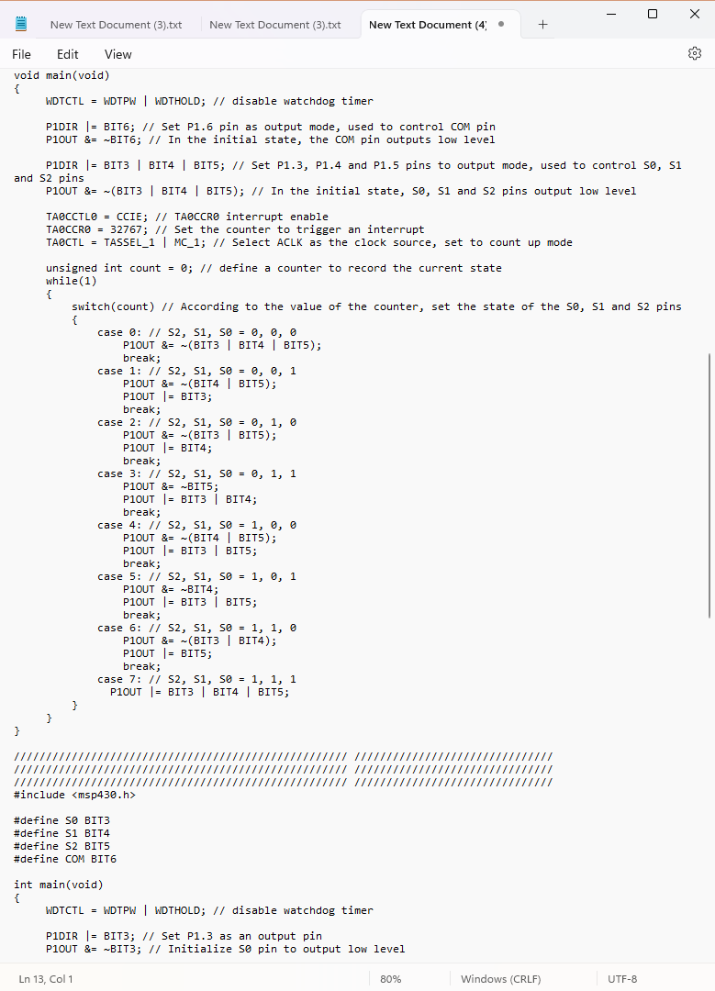
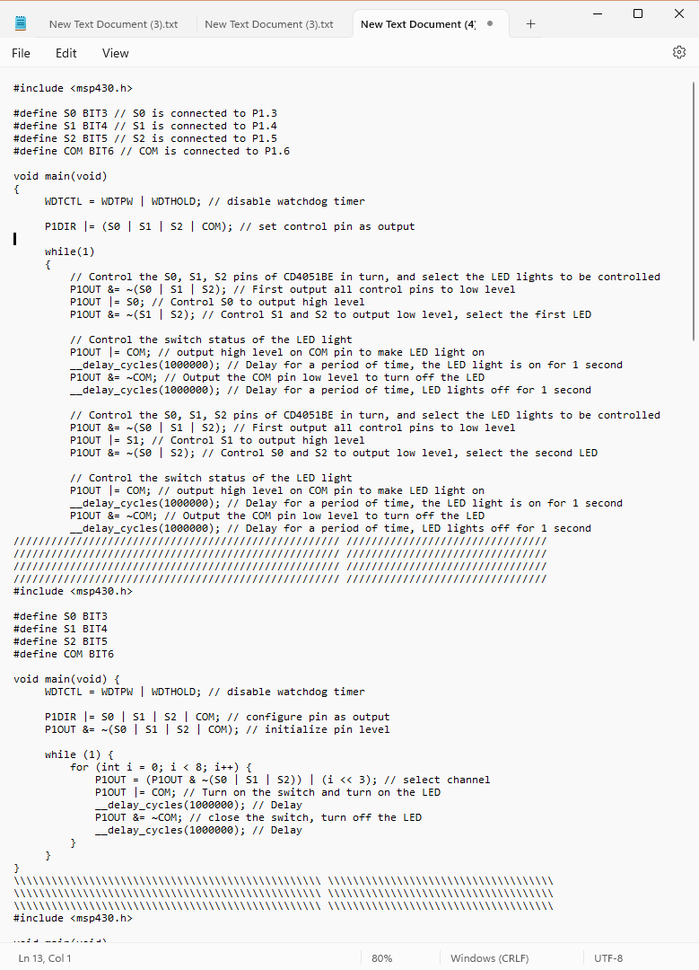
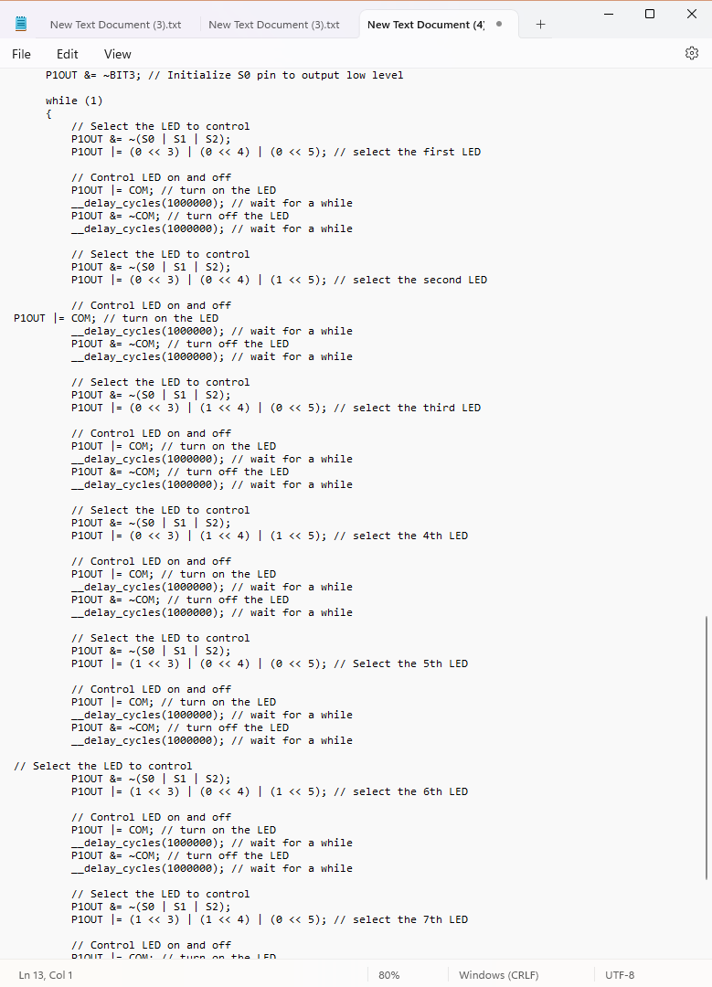
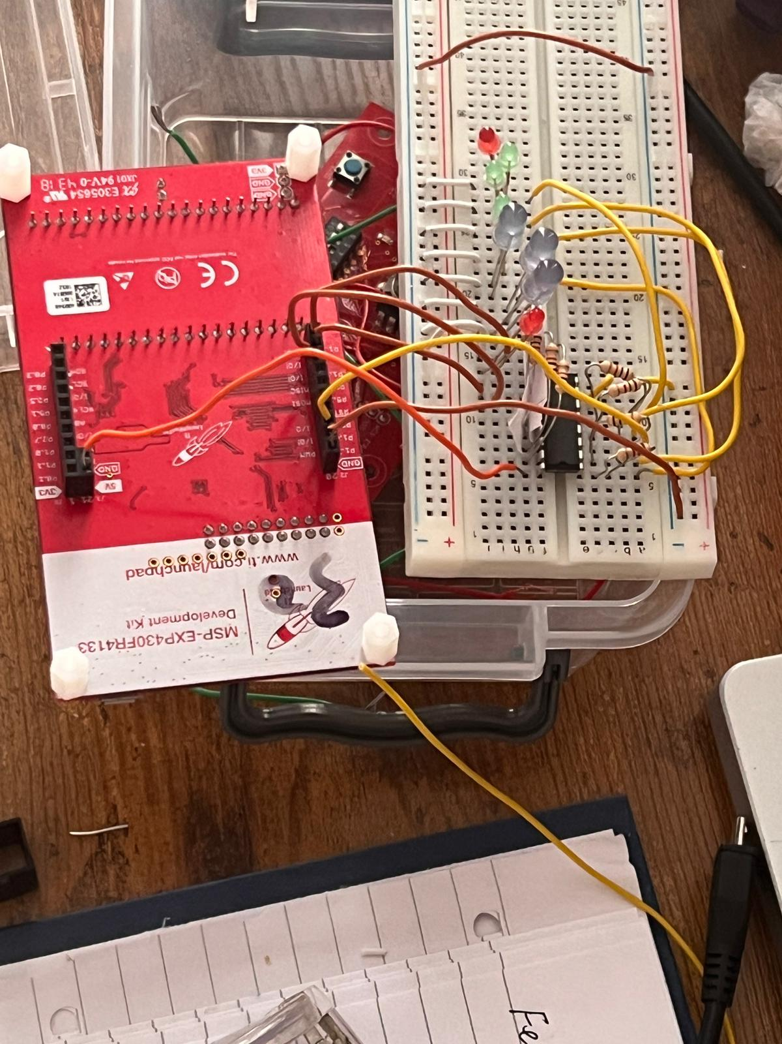
LED indicators

Slide 6
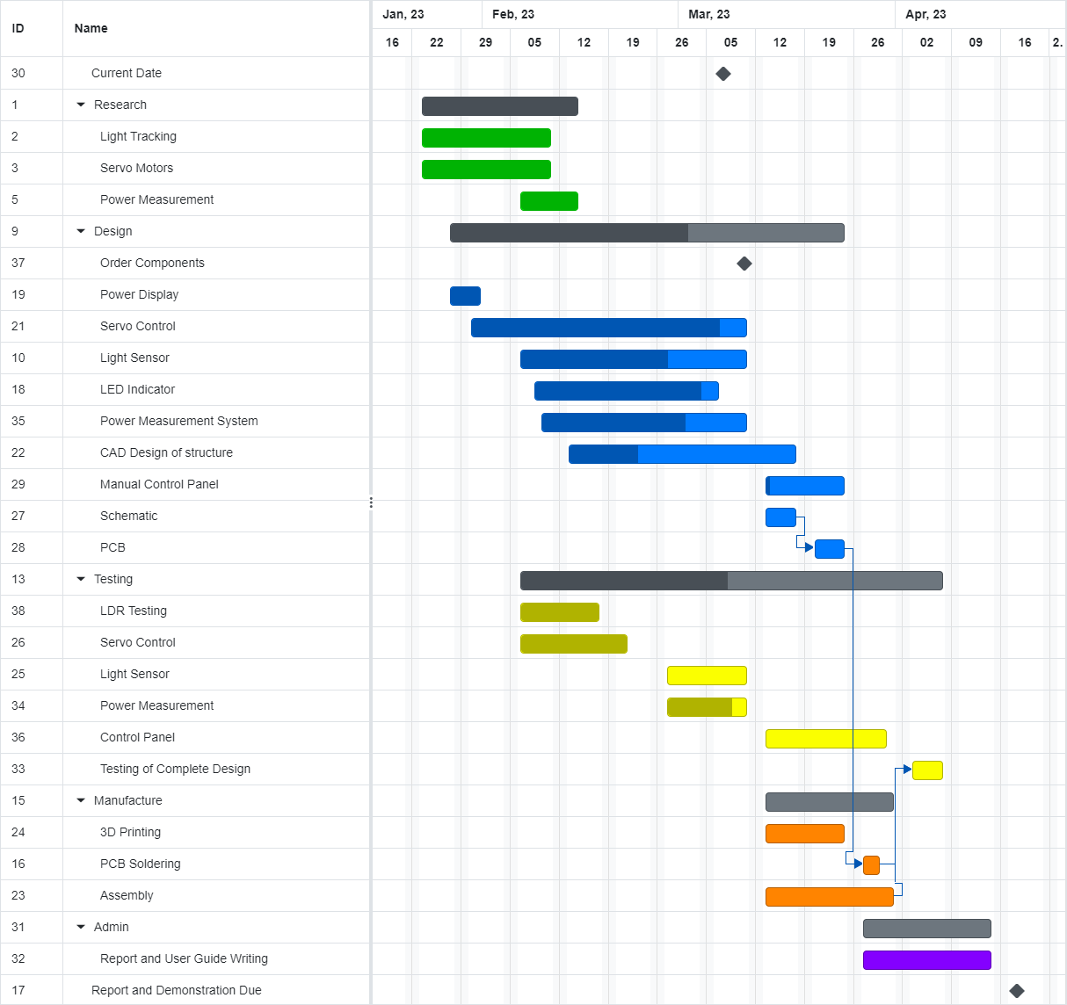
Updated Project Plan

Slide 7
